Slide 1

Chapter 3
The vector space R^{n}
Notes:
The basis theory of finite dimensional vector space such concepts as subspaces, spanning sets, linear independence and dimension.
The pace is slow because this is the first acquaintance may students have had with an abstract system.

Slide 2
Contents
3.1. Subspaces of R^{n}
3.2. Linear combinations.
3.3. Independence
3.4. Basis and dimension
3.5. RowA, colA and nullA subspaces.
3.6. Diagonalization and Eigenvalues

Slide 3




3.1.Subspace of R^{n}
•
•
Definition of subspace of R^{n}.
Let Ø≠U be a subset of R^{n}
U is called a subspace of R^{n} if:
◆ The zero vector 0 is in U
❖ If X,Y are in U then X+Y is in U
⬥ If X is in U then aX is in U for all real number a.
• •
•
•
vector
zero vector
•
aX
• •
•
•
•
•
•
X+Y
Y
X

Slide 4
3.1.Subspace of R^{n}
Example 1:
U={(a,a,0)|aR} is a subspace of R³

Slide 5
3.1.Subspace of R^{n}
Example 1:
U={(a,a,0)|aR} is a subspace of R³
◆ the zero vector of R³, (0,0,0)U
❖ (a,a,0), (b,b,0)U(a,a,0)+(b,b,0)=(a+b,a+b,0)U
⬥ If (a,a,0) U and k R, then k(a,a,0)=(ka,ka,0)U

Slide 6
3.1. Subspace of R^{n}
Nhận xét:
Các trường hợp sau không là không gian vector con
1/ Có thành phần luôn khác không.
2/ Có hai hệ số chênh lệch một hằng số.
3/ Có bậc lớn hơn 1.
4/ Có hệ số bậc cao hoặc tích
5/ Có chứa trị tuyệt đối

Slide 7
3.1.Subspace of R^{n}
Example 2:
U={(a,b,1): a,b R} is not a subspace of R³
◆ (0,0,0)U  U is not a subspace
Example 3:
U={(a,|a|,0)|a R} is not a subspace of R³
❖ (-1,|-1|,0), (1,|1|,0)U but (0,2,0) U  U is not a subspace

Slide 8
Example 4:
3.1.Subspace of R^{n}
Determine whether U is a subspace of R³.
a/ U={[0 a b]^{T}: a,b  R}
b/ U={[0 1 s]^{T}:s  R}
c/ U={[a b a+1] ^{T}:a,b  R}
d/ U={[a b a²]^{T}: a, b  R}

Slide 9
Solution:
3.1.Subspace of R^{n}
Determine whether U is a subspace of R³.
U={[0 a b]^{T}: a,b  R} 
U={[0 1 s]^{T}:s  R}
U={[a b a+1] ^{T}:a,b  R}
U={[a b a²]^{T}: a, b  R}
Nhận xét:
không là subspace khi
có hằng số khác 0
có hai hệ số chênh lệch 1 hằng số
có bậc lớn hơn 1

Slide 10
3.1.Subspace of R^{n}
Example 5:
V={[0 a 0]^{T} in ○³: a Z}
U={[a 7 3a]^{T} in ○³: aR}
W={[5a b a-b]^{T} in ○³: a,bR}

Slide 11
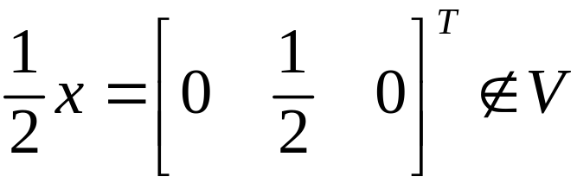
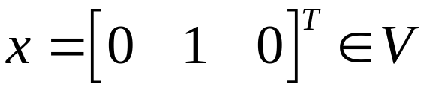
3.1. Subspace of R^{n}
Solution:
V={[0 a 0]^{T} in ○³: a Z}
but
⇒ V is not a subspace
U={[a 7 3a]^{T} in ○³: aR}
(0,0,0)U  U is not a subspace.
W={[5a b a-b]^{T} in ○³: a,bR} is a subspace.

Slide 12
3.1. Subspace of R^{n}
Example 6
Q={[a b |a+b|]^{T} in ○³ :a,b ○}
H={[a b ab]^{T} in ○³ : a,b ○}
P={(x,y,z)| x-2y+z=0 and 2x-y+3z=0}.

Slide 13
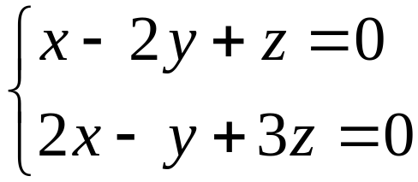
3.1. Subspace of R^{n}
Solution:
Q = {[a b |a+b|]^{T} in ○³ :a,b ○} is not a subspace.
H = {[a b ab]^{T} in ○³ : a,b ○} is not a subspace.
P = {(x,y,z)| x-2y+z=0 and 2x-y+3z=0} is a subspace.
P is called the solution space of the system

Slide 14
3.1. Subspace of R^{n}
Note:
A subspace either has only one or infinite many vectors
Example:
{0} has only vector.
If a subspace U has nonzero vector X then aX is also in U. Then U has infinite many vector

Slide 15

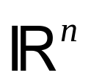
3.1.Subspace of R^{n}
Null space and image space of a matrix
A is an mxn matrix, if X is nx1 matrix then AX is mx1 matrix
nullA = {X in R^{n}: AX=0} imA = {AX: X is in R^{n}}
A
nullA
•
imA
zero vector
nullA ={X R^{n}:AX=0} is a subspace of
R^{n}:
◆ A.0=00nullA
❖ X,Y nullA AX=0, AY=0 A(X+Y)=AX+AY=0 (X+Y) nullA
⬥ X nullA, a R  AX=0  A(aX)=a(AX)=0  aXnullA
imA ={AX:X  R^{n}}is a subspace of R^{m}:
◆ 0=A.00imA
❖ AX,AY imA AX+AY=A(X+Y)=AZ
AX+AY imA
⬥ AX imA, a R  a(AX)=A(aX)=AZ  a(AX)imA

Slide 16
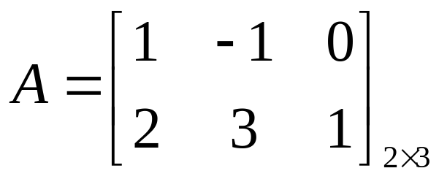
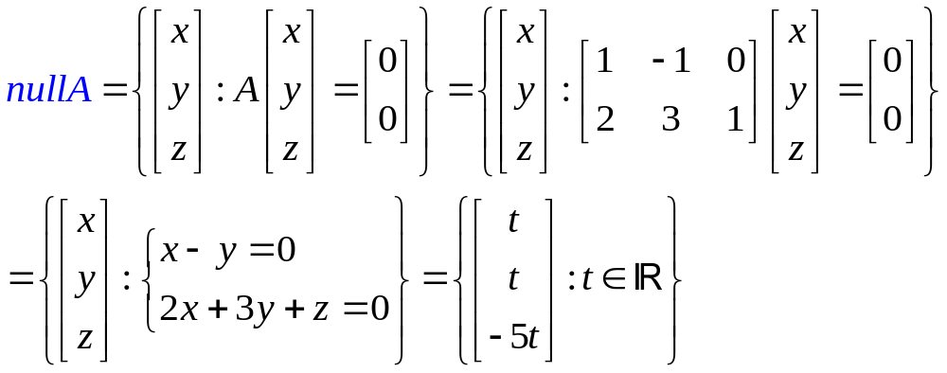
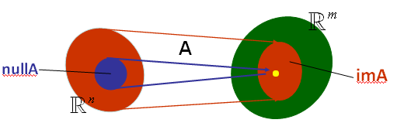
3.1. Subspace of R^{n}
Null space nullA={X:AX=0}
Example:

Slide 17
3.2. Linear combinations
Y=k₁X₁+k₂X₂+…+k_{n}X_{n} is called a linear
combination of the vectors X₁,X₂,…,X_{n}
The set of all linear combinations of the the vectors X₁,X₂,…,X_{n} is called the span of these vectors, denoted by span{X₁,X₂,…,X_{n} }.
This means, span{X₁,X₂,…,X_{n}} = {k₁X₁+k₂X₂+…+k_{n}X_{n} :k_{i}R is arbitrary}
span{X₁,X₂,…,X_{n}} is a subspace of R^{n}.

Slide 18
3.2. Linear combinations
Example 1:
span{(1,0,1),(0,1,1)}={a(1,0,1)+b(0,1,1) :a,bR}.
And we have (1,2,3)span{(1,0,1),(0,1,1)} because (1,2,3)= 1(1,0,1)+ 2(0,1,1).
(2,3,2)span{(1,0,1),(0,1,1)} because (2,3,2)≠a(1,0,1)+b(0,1,1) for all a,b.

Slide 19
3.2. Linear combinations
Nếu U=span{X,Y} ta nói U là KG được sinh ra bởi {X,Y} hay hệ {X,Y} sinh ra KG U. Khi đó, U chứa tất cả các vector có dạng aX+bY với a, b là các số thực tùy ý.
vector Zspan{X,Y} khi và chỉ khi có các số thực a,b sao cho Z=aX+bY hay hệ pt Z=aX+bY có nghiệm a,b.
Ta cũng nói Z là một tổ hợp tuyến tính (linear combination) của X,Y khi Z=aX+bY hay Zspan{X,Y}.

Slide 20
3.2. Linear combinations
Example 2:
If x=(1,3,-5) is expressed as a linear combination of the vectors v₁ = (1, 1, 1); v₂ =(1,1,-1); v₃ = (1, 0, 2); then the coefficient of v₃ is:
A. 2 B. 3 C. -2  D. 1 E. 0
Notes:
Lưu ý A, D là các tổ hợp tuyến tính (linear combination) của u, v bởi vì các hệ pt tương ứng A=au+bv, D=au+bv có nghiệm a,b.
BT: 1
2 p.235

Slide 21
3.2. Linear combinations
Solution:
x is expressed as a linear combination of v₁, v₂, v₃ means x=av₁+bv₂+cv₃ for some a,b,c and c is called the coefficient of v₃.
the system is
a + b + c = 1
a + b = 3
a – b +2c = - 5
Solution:
a =1;b =2; c =-2.
Notes:
Lưu ý A, D là các tổ hợp tuyến tính (linear combination) của u, v bởi vì các hệ pt tương ứng A=au+bv, D=au+bv có nghiệm a,b.
BT: 1
2 p.235

Slide 22
3.2. Linear combinations
Example 3:
Which of the vectors below is a linear combination of u=(1,1,2); v=(2,3,5)?
A. (0,1,1) B. (1,1,0)
C. (1,1,1) D. (1,0,1)
E. (0,0,1)
Notes:
Lưu ý A, D là các tổ hợp tuyến tính (linear combination) của u, v bởi vì các hệ pt tương ứng A=au+bv, D=au+bv có nghiệm a,b.
BT: 1
2 p.235

Slide 23
3.2. Linear combinations
Solution:
A. (0,1,1)  D. (1,0,1) 
Notes:
Lưu ý A, D là các tổ hợp tuyến tính (linear combination) của u, v bởi vì các hệ pt tương ứng A=au+bv, D=au+bv có nghiệm a,b.
BT: 1
2 p.235

Slide 24
3.2. Linear combinations
Example 4:
a/ If (x,y,z) is expressed as a linear combination of vectors v1=(1,1,-1); v2=(1,0,1) and v3=(-1,0,1) then what is the coefficient of v3 ?
b/ Let U=span{(1,2,3);(3,4,5)}. Find m such that (3,5,m) lies in U.

Slide 25
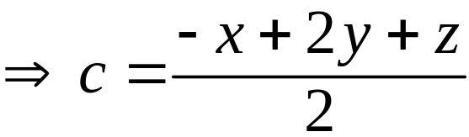
3.2. Linear combinations
Solution:
a/ w=(x,y,z) is expressed as a linear combination of v₁, v₂, v₃ means w = av₁+bv₂+cv₃ for some a,b,c and c is called the coefficient of v₃.
the system is
a + b - c = x
a = y
-a +b + c = z

Slide 26
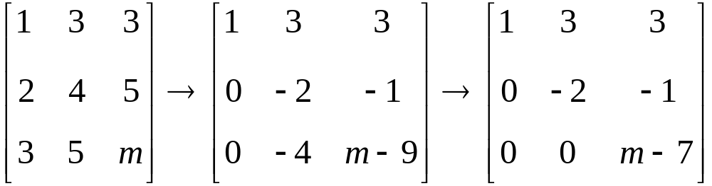
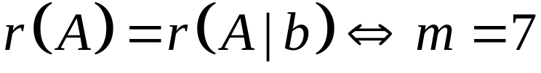
3.2. Linear combinations
Solution:
b/ w=(3,5,m) lies in U if and only if w=(3,5,m) is expressed as a linear combination of v₁=(1,2,3), v₂=(3,4,5) means w = av₁+bv₂
We have
The system has solution if and only if

Slide 27



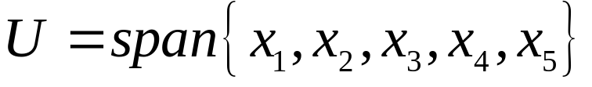
3.2. Linear combinations
Theorem
U=span{X₁,X₂,…,X_{n}} is in R^{n} and U is a subspace of R^{n}
If W is a subspace of R^{n} such that X_{i} are in W then
•
• •
•
•

Slide 28
3.3. Linear Independence
(sự độc lập tuyến tính)
A set of vectors in R^{m} {X₁,X₂,…,X_{n} } is called linearly independent (độc lập tuyến tính)
if t₁X₁+t₂X₂+…+t_{n}X_{n}=0  t₁=t₂=…=t_{n}=0 only
numbers in R
vectors in R^{m}

Slide 29
3.3. Linear Independence
Example 1:
The set S ={[1 -1]^{T}, [2 3]^{T}}R² is called linearly independent since t₁[1 -1]^{T} + t₂[2 3]^{T} = [0 0]^{T} follows t₁=t₂=0.
Example 2:
The set {(0,1,1), (1,-1,0), (1,0,1)} is not linearly independent because the system
t₁(0,1,1)+t₂(1,-1,0)+t₃(1,0,1)=(0,0,0)
has one solution t₁= -1, t₂= -1, t₃=1

Slide 30
3.3. Linear Independence
Example 1:
The set S ={[1 -1]^{T}, [2 3]^{T}}R² is called linearly independent since t₁[1 -1]^{T} + t₂[2 3]^{T} = [0 0]^{T} follows t₁=t₂=0.
Example 2:
The set {(0,1,1), (1,-1,0), (1,0,1)} is not linearly independent because the system
t₁(0,1,1)+t₂(1,-1,0)+t₃(1,0,1)=(0,0,0)
has one solution t₁= -1, t₂= -1, t₃=1

Slide 31
3.3. Linear Independence
Example 3:
A set of vectors that containing zero vector never linearly independent.

Slide 32
3.3. Linear Independence
Example 4:
Show that {(1,1,0);(0,1,1);(1,0,1)} is linearly independent in R³

Slide 33
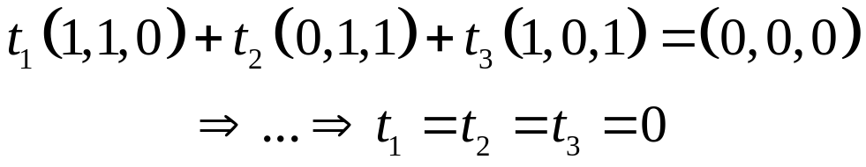
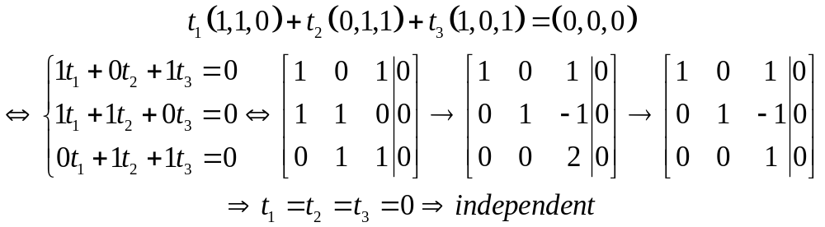
3.3. Linear Independence
Solution
Show that {(1,1,0);(0,1,1);(1,0,1)} is linearly independent in R³
Fast way to determine a set of vectors is independent or not:
independent ⇔ Number of leading 1s = member of vectors
More ex. {(1,0,-2), (2,1,0), (0,1,5), (-1,1,0)} is not linearly independent (number of leading 1s = member of vectors)
1 | 2 | 0 | -1
0 | 1 | 1 | 1
-2 | 0 | 5 | 0
1 | 2 | 0 | -1
0 | 1 | 1 | 1
0 | 4 | 5 | 2
1 | 2 | 0 | -1
0 | 1 | 1 | 1
0 | 0 | 1 | -2

Slide 34
3.3. Linear Independence
Example 5:
Determine whether each the following sets is linearly independent or linearly dependent.
a/ {(-1,2,0)}
b/ {(0,0,0); (1,2,3); (-3,0,1)}
c/ {(1,1,-1); (-1,1,1); (1,-1,1)}
d/ {(-2,3,4,1); (4,-1,5,0); (-2,1,0,3)}
e/ {(1,1,0); (-2,3,1); (5,0,1); (-1,0,2)}
f/ {X-Y+Z,3X+Z,X+Y-Z}, where {X,Y,Z} is an independent set of vectors.

Slide 35
3.3. Linear Independence
Solution
a/ {(-1,2,0)} Linear Independence
b/ {(0,0,0); (1,2,3); (-3,0,1)} Linear dependence
c/ {(1,1,-1); (-1,1,1); (1,-1,1)} Linear Independence
d/ {(-2,3,4,1); (4,-1,5,0); (-2,1,0,3)} Linear Independence
e/ {(1,1,0); (-2,3,1); (5,0,1); (-1,0,2)} Linear dependence
f/ {X-Y+Z,3X+Z,X+Y-Z}, where {X,Y,Z} is an independent set of vectors. Linear Independence

Slide 36
3.3. Linear Independence
Example 6:
a/Find all x in R such that {(1,1,1,1);(2,3,2,3),(3,4,1,x)} is a linearly independent set.
b/ For what value of a is the set of vectors S={(1,1,1,1); (3,2,1,5);(2,3,0,a-11)} is linearly dependent ?
c/ Find all m such that the set {(2,m,1),(1,0,1),(0,1,1)} is linearly independent.

Slide 37


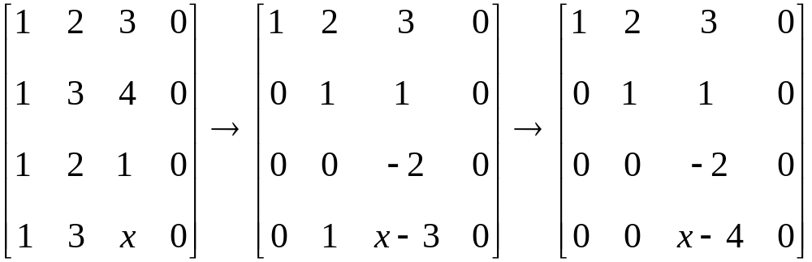
3.3. Linear Independence
Solution:
a/ Set u = (1,1,1,1);v = (2,3,2,3); w = (3,4,1,x)
a(1,1,1,1) +b (2,3,2,3)+c (3,4,1,x) = (0,0,0).

Slide 38
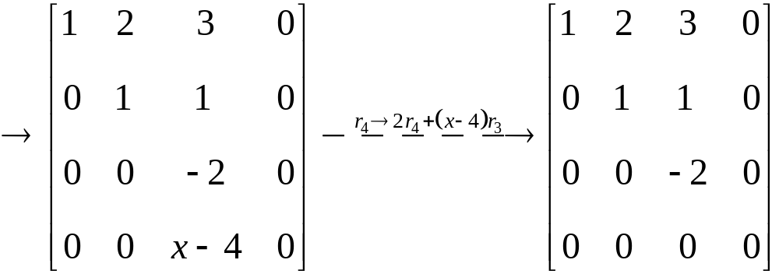
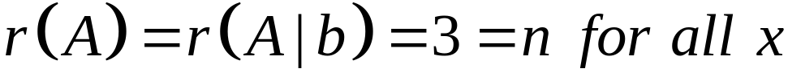

3.3. Linear Independence
Solution:
{(1,1,1,1);(2,3,2,3),(3,4,1,x)} is a linearly independent set for all .

Slide 39

3.3. Linear Independence
Solution:
b/ For what value of a is the set of vectors S={(1,1,1,1); (3,2,1,5);(2,3,0,a-11)} is linearly dependent ?
Answer: a doesn’t exist.
c/ Find all m such that the set {(2,m,1),(1,0,1),(0,1,1)} is linearly independent.
Answer:

Slide 40
3.3. Linear Independence
Fundamental Theorem
Let U be a subspace of R^{n} is spanned by m vectors, if U contains k linearly independent vectors, then k≤n.
This implies if k>n, then the set of k vectors is always linear dependence.
Example
Let U be the space spanned by {(1,0,1), (0,-1,1)} and S={(1,0,1), (0,-1,1), (2,-1,3)} U.
Then, S is not linearly independent (m=2, k=3).

Slide 41
3.3. Linear Independence
Note:
1/ Tập chứa vector không luôn phụ thuộc tuyến tính.
2/ Tập có 1 vector khác vector không thì độc lập tuyến tính.
3/ Tập có số vector lớn hơn số chiều luôn luôn phụ thuộc tuyến tính.
4/ Tập có 2 vector độc lập tuyến tính khi và chỉ khi cả
hai vector khác vector không và không cùng phương
(các thành phần tỉ lệ không bằng nhau)

Slide 42
3.4. Basis and dimension
(cơ sở và chiều của KG)
Definition of basis:
Suppose U is a subspace of R^{n}, a set {X₁,X₂,…,X_{k}} is called a basis of U if
U=span{X₁,X₂,…,X_{k}} , B ={X₁,X₂,…,X_{k}}
and
B={X₁,X₂,…,X_{k}} is linear independence.

Slide 43
3.4. Basis and dimension
Example 1:
Let U={(a,-a)|aR}. Then U is a subspace of R². Consider the set B={(1,-1)}.
B is linearly independent
and
U={(a,-a):aR}={a(1,-1): aR } =span{(1,-1)}.
So, B is a basis of U.
Note that B’={(-1,1)} is also a basis of U.
But {(1,1)} is not a basis of U because U can not be spanned by {(1,1)}

Slide 44
3.4. Basis and dimension
Example 2:
Given that V=span{(1,1,1), (1,-1,0), (0,2,1)}.
Then, B={(1,1,1), (1,-1,0), (0,2,1)} is not linearly independent, because (0,2,1)=(1,1,1) – (1,-1,0)
So, B is not a basis of V.
Consider B’={(1,1,1), (1,-1,0)}.
B’ is linearly independent and all vectors in V are spanned by B’ because a(1,1,1)+ b(1,-1,0)+ c(0,2,1) =a(1,1,1)+ b(1,-1,0)+ c(1,1,1) –c(1,-1,0) = (a+c)(1,1,1)+(b-c)(1,-1,0).
So, B’ is a basis of V.

Slide 45
3.4. Basis and dimension
Example 2:
Given that V=span{(1,1,1), (1,-1,0), (0,2,1)}.
Then, B={(1,1,1), (1,-1,0), (0,2,1)} is not linearly independent, because (0,2,1)=(1,1,1) – (1,-1,0)
So, B is not a basis of V.
Consider B’={(1,1,1), (1,-1,0)}.
B’ is linearly independent and all vectors in V are spanned by B’ because a(1,1,1)+ b(1,-1,0)+ c(0,2,1) =a(1,1,1)+ b(1,-1,0)+ c(1,1,1) –c(1,-1,0) = (a+c)(1,1,1)+(b-c)(1,-1,0).
So, B’ is a basis of V.

Slide 46
3.4. Basis and dimension
Theorem 1 (Invariance theorem).
If {a₁,a₂,..,a_{m}} and {b₁,b₂,…,b_{k}} are bases of a subspace U of R^{n,} then m=k. In this case, m=k is called dimension of U and we write dimU=m.

Slide 47
3.4. Basis and dimension
Example 1:
Let U={(a,-a)|aR} be a subspace of R². Then, B={(1,-1)} is a basis of U and B’={(-1,1)} is also a basis of U.
In this case, dimU=1.
Example 2:
{(1,0), (0,1)} is a basis of R² and {(1,-2), (2,0)} is also a basis of R². But {(1,0), (-1,1), (1,1)} is not a basis of R².
We have dimR²=2.
The basis {(1,0), (0,1)} is called standard basis of R².

Slide 48
3.4. Basis and dimension
Example 3:
Which of the following is a basis of R³?
◆ {(1,0,1), (0,0,1)}
❖ {(2,1,0), (-1,0,1), (1,0,1), (0,-1,1)}
⬥ {(0,1), (1,0)}
 None of the others

Slide 49
3.4. Basis and dimension
Theorem 2
Let U be a subspace of R^{n} and B={X₁,X₂,…,X_{m}}U, where dimU=m. Then B is independent if and only if B spans U.

Slide 50
3.4. Basis and dimension
Example:
Find all values of m so that {(2,-1,3); (0,1,2); (-4,0; m)} spans R³.

Slide 51
3.4. Basis and dimension
Solution:
So, {(2,-1,3); (0,1,2); (3,1; m)} spans R³ ⇔ it is linearly independent ⇔ m≠10

Slide 52
3.4. Basis and dimension
Nhận xét: Trong R^{n},
1/ mọi tập có n vector độc lập đều là cơ sở.
2/ mọi tập sinh có n vector đều là cơ sở.
3/ mọi tập có số vector lớn hơn n luôn phụ thuộc tuyến tính.
4/ mọi tập độc lập tuyến tính có số vector nhỏ hơn n không thể là tập sinh.

Slide 53
3.4. Basis and dimension
Theorem 3
The following are equivalence for an nxn matrix A.
◆ A is invertible.
❖ the columns of A are linearly independent.
⬥ the columns of A span R^{n}.
 the rows of A are linearly independent.
 the rows of A span the set of all 1xn rows.

Slide 54
3.4. Basis and dimension
Theorem 4
Let U≠0 be a subspace of R^{n}. Then:
◆ U has a basis and dimUn.
❖ Any independent set of U can be enlarged (by adding vectors) to a basis of U.
⬥ If B spans U, then B can be cut down (by deleting vectors) to a basis of U.

Slide 55
3.4. Basis and dimension
Example 1:
Let U=span{(1,1,1), (1,0,1), (1,-2,1)} be a subspace of R³.
Find the basis of U.

Slide 56
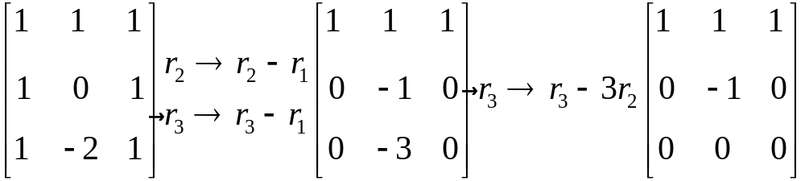
3.4. Basis and dimension
Solution: Set B= {(1,1,1), (1,0,1), (1,-2,1)}.
Construct a basis for U
A basis for U is E ={(1,0,1), (0,-1,0)}.
Cũng có thể chọn 2 vector 1 và 2; 1 và 3 hoặc 2 và 3 làm cơ sở.

Slide 57

3.4. Basis and dimension
Example 2:
Let U=span{(-2, 0, 3), (1, 2, -1),(-2, 8, 5),(-1, 2, 2)} is the subspace of . Find the basis and dimension of U.

Slide 58
3.4. Basis and dimension
Example 3:
Let U={[a b a-b]^{T}: a,b R} is the subspace of . Find the basis and dimension of U.

Slide 59
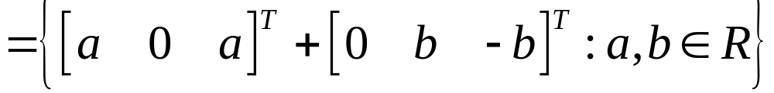
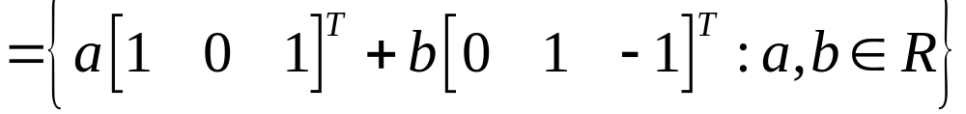
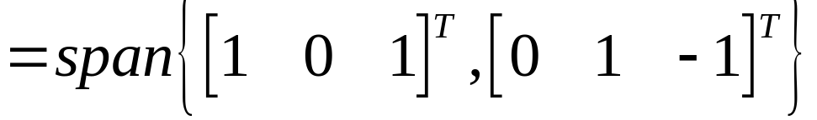
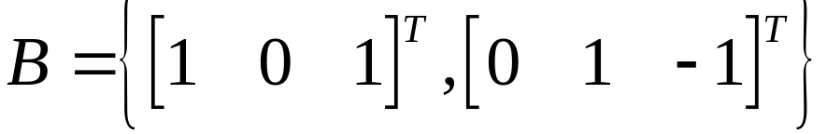

3.4. Basis and dimension
Solution:
We have U={[a b a-b] ^{T} : a,b R}
And is linear independent.
Hence, is a basis of U and

Slide 60
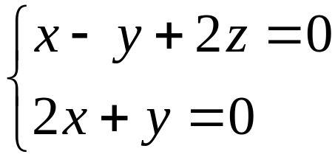
3.4. Basis and dimension
Example 4:
Find a basis and dimension for the solution space to the homogeneous system

Slide 61

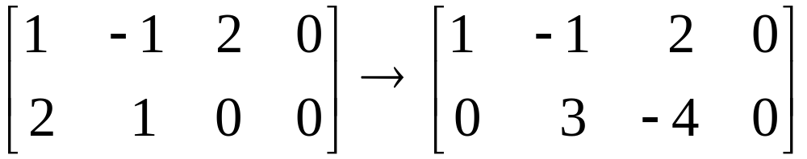
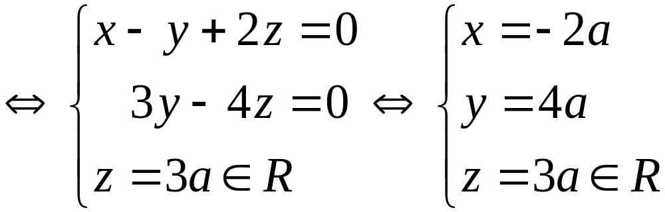
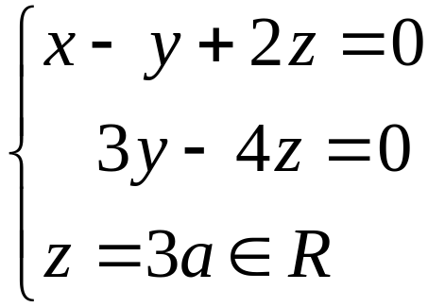
3.4. Basis and dimension
Solution:Let is the solution space to the
homogeneous system
We have
The system

Slide 62
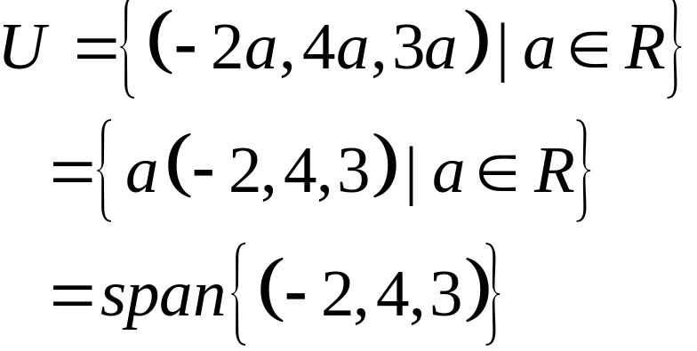
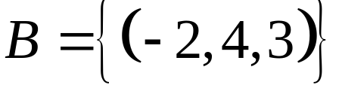
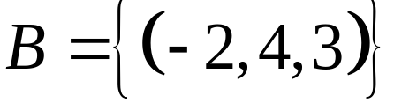

3.4. Basis and dimension
Solution:
and is linear independent.
Hence, is basis of and .

Slide 63
3.4. Basis and dimension
Theorem 5
Let UV be subspaces of R^{n}. Then:
◆ dimU  dimV.
❖ If dimU=dimV, then U=V.

Slide 64
3.4. Basis and dimension
If {x₁,x₂,…,x_{m}} is a basis of U then dimU=m
dimR^{n}=n
Note that if U=span {x₁,x₂,…,x_{m}} then dimU≤m and dimU=m if and only if {x₁,x₂,…,x_{m}} is linear independent
If dimU=m then every set of m+1 vector in U is linearly dependent
Every set of n linearly independent vectors is a basis of R^{n} ( mỗi tập gồm n vector đltt của R^{n} đều là một cơ sở của R^{n})

Slide 65
Exercises
3.4. Basis and dimension
Question 1:
Let U=span{(1,-1,1), (0,2,1)}. Find all value(s) of m for which (3,-1,m)U.

Slide 66
Exercises
3.4. Basis and dimension
Solution:
(3,-1,m) U⇔ (3,-1,m)= a(1,-1,1) + b(0,2,1) for some a,b. Solve for a,bm=4

Slide 67
Exercises
3.4. Basis and dimension
Question 2:
A basis for the subspace U={[a b a-b]^{T}: a,b R} is…
a. {[1 0 1]^{T}, [0 1 -1]^{T}}
b. {[1 1 0]^{T}}
c. {[1 0 1]^{T}, [-1 0 -1]^{T}, [0 1 -1]^{T}}
d. None of the others.

Slide 68
Exercises
3.4. Basis and dimension
Solution:
A basis for the subspace U={[a b a-b]^{T}: a,b R} is…
a. {[1 0 1]^{T}, [0 1 -1]^{T}} 
b. {[1 1 0]^{T}}
c. {[1 0 1]^{T}, [-1 0 -1]^{T}, [0 1 -1]^{T}}
d. None of the others.
Nhận xét:
U phụ thuộc 2 tham số nên dimU=2 và mọi cơ sở đều phải có đúng 2 vector độc lập tuyến tínhchỉ có thể là a hoặc d.
kiểm tra a: độc lập và sinh ra U

Slide 69
Exercises
3.4. Basis and dimension
Question 3: The dimension of the subspace U=span{(-2, 0, 3), (1, 2, -1),(-2, 8, 5),(-1, 2, 2)} is…
a. 2 b. 4 c. 3 d. 1

Slide 70
Exercises
3.4. Basis and dimension
Solution: The dimension of the subspace U=span{(-2, 0, 3), (1, 2, -1),(-2, 8, 5),(-1, 2, 2)} is…
a. 2 b. 4 c. 3 d. 1
cannot b because dimUdimR³=3
Check by Elementary Operations

Slide 71
Exercises
3.4. Basis and dimension
Question 4: Let u and v be vectors in R³ and w  span{u,v}. Then …
a. {u,v,w} is linearly dependent.
b. {u,v,w} is linearly independent.
c. {u,v,w} is a basis of R³
d. the subspace is spanned by {u,v,w} has the dimension 3.

Slide 72
Exercises
3.4. Basis and dimension
Solution: Let u and v be vectors in R³ and w  span{u,v}. Then …
a. {u,v,w} is linearly dependent. 
b. {u,v,w} is linearly independent.
c. {u,v,w} is a basis of R³
d. the subspace is spanned by {u,v,w} has the dimension 3.
w  span{u,v} means w=au+bv {u,v,w} is not independent
lưu ý cũng không có gì chắc chắn {u,v} độc lập nên dimU2

Slide 73
Exercises
3.4. Basis and dimension
Question 5: Let {u,v,w,z} be independent. Then …. is also independent.
a. {u,v+w,z}
b. {u,v,v-z-u,z}
c. {u+v,u-w,z, v+z+w}
d. {u,v,w,u-v+w}

Slide 74
Exercises
3.4. Basis and dimension
Solution: Let {u,v,w,z} be independent. Then …. is also independent.
a. {u,v+w,z} 
b. {u,v,v-z-u,z}
c. {u+v,u-w,z, v+z+w}
d. {u,v,w,u-v+w}

Slide 75
Exercises
3.4. Basis and dimension
Question 6:
Find a basis for the subspace of R³ defined by
U={(a,b,c): 2a-b+3c=0}
{(1,2,0), (0,3,1)} b. {(1,0,0), (0,1,0), (0,0,1)}
c. {(1,2,0)} d. {(1,0,0), (1,2,0)}
e. {(3,0,-2), (1,0,0)} f. {(2,-1,3)}

Slide 76
Exercises
3.4. Basis and dimension
Solution:
Find a basis for the subspace of R³ defined by
U={(a,b,c): 2a-b+3c=0}
{(1,2,0), (0,3,1)}  b. {(1,0,0), (0,1,0), (0,0,1)}
c. {(1,2,0)} d. {(1,0,0), (1,2,0)}
e. {(3,0,-2), (1,0,0} f. {(2,-1,3)}
Nhận xét:
Nghiệm phụ thuộc 2 tham sốdimU=2 và mọi cơ sở của U phải có đúng 2 vector chỉ a,d hoặc e đúng
các vector trong cơ sở cũng phải thuộc U nên dễ thấy (1,0,0) không thuộc U loại d,e.

Slide 77
Exercises
3.4. Basis and dimension
Question 7:
Find a basis and dimension for the subspace of R³ defined by U={(a,b,a-b)|a,bR}

Slide 78
Exercises
3.4. Basis and dimension
Solution:
U={a(1,0,1)+b(0,1,-1)|a,bR}=span{(1,0,1), (0,1,-1)}
{(1,0,1), (0,1,-1)} spans U and independent  {(1,0,1), (0,1,-1)} is a basis and dimU=2
Nhận xét:
U phụ thuộc 2 tham số  dimU=2
Có thể chọn ngay một cơ sở của U bằng cách chọn 2 vetor thuộc U và 2 vector này độc lập tuyến tính.
Có nhiều cơ sở khác của U, ví dụ {(-1,0,-1), (0,1,-1)},…

Slide 79

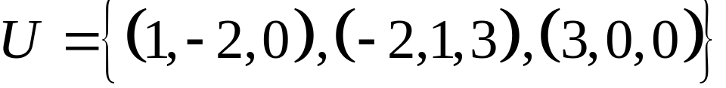
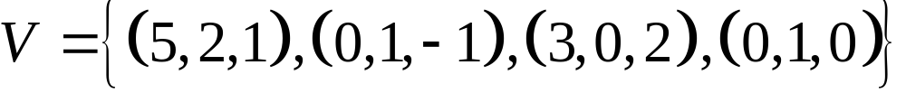
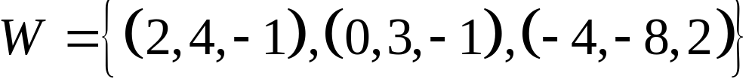
Exercises
3.4. Basis and dimension
Question 8:
Which of the following are bases for ?
(i)
(ii)
(iii)
All of them b. (i) only
(i) and (ii) only d. (i) and (iii) only
e. None of them

Slide 80
3.4. Basis and dimension
Do yourself
Question 1: Find all values of m for which (1,2,m) lies in the subspace spanned by {(1,0,-1), (0,1,2)}
Question 2: Find all m such that (-3,2,m) is a linear combination of two vectors (1,1,-1) and (-2, 3, 4).
Question 3: Determine {x-y,x+y-z,x+z} is independent or not, where {x,y,z} is independent.
Question 4: Determine whether each of the following sets is a basis of R³ or not:
a/ {(1,0,-1), (0,1,2), (3,1,-1)}
b/ {(0,1,1), (-1,2,1)}
c/ {(1,0,0), (1,1,0), (1,1,1), (0,0,1)}

Slide 81
3.4. Basis and dimension
Do yourself
Question 4: Determine whether each of the following sets is a basis of R³ or not:
a/ A = {(1,0,-1), (0,1,2), (3,1,-1)}
b/ B = {(0,1,1), (-1,2,1)}
c/ C = {(1,0,0), (1,1,0), (1,1,1), (0,0,1)}
d/ D = {(-1,0,3);(3,0,-1)}
e/ E = {(1,-1,2);(3,0,1);(1,1,0)}
f/ F = {(7,-1,4);(0,0,1);(1,-1,0);(0,1,5)}

Slide 82
3.4. Basis and dimension
Do yourself
Question 5: Find a basis and dimU if:
a/ U=span{(-1,4,3);(3,0,-2);(-6,2,0)}
b/ U=span{(1,-1,3,0);(5,-2,4,3);(-2,0,7,1)}
c/ U=span{(1,1,1);(1,-1,1);(-1,0,1);(0,-1,1)}
d/ U=span{(1,-1,2,0);(-2,1,0,1);(-1,0,0,1); (1,0,1,2)}
e/ U={[a b 0]^{T}: a,b in R} f/ U={(a,b,c):a+b+c=0}

Slide 83
3.5. RowA, colA and nullA subspaces
If A is carried to row-echelon form then rankA=number of leading 1’s
If A is an mxn matrix then rankA≤min{n,m}
rankA=rank(A^{T})

Slide 84
3.5. RowA, colA and nullA subspaces
Let mxn matrix A.
rowA = span{rows of matrix A}
colA = span{columns of A}
dim(rowA )=dim(colA)=rankA
nullA={X| AX=0}
dim(nullA) = n-r, r =rankA

Slide 85

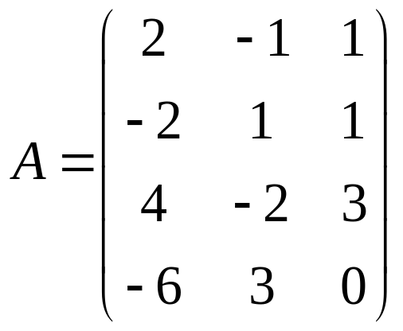
3.5. RowA, colA and nullA subspaces
Example 1:
Find bases for the row and column spaces of
and determine the rank of

Slide 86

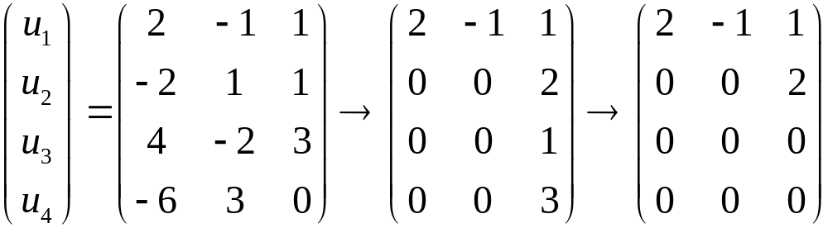
3.5. RowA, colA and nullA subspaces
Solution:
Set
rowA = span{ }
We have

Slide 87
3.5. RowA, colA and nullA subspaces
Solution:
rowA = span{ }=span{(2,-1,1),(0,0,2)}
Because B = {(2,-1,1),(0,0,2)} is linear independent.
So, B = {(2,-1,1),(0,0,2)}is a basis of rowA.
dim(rowA)=2.

Slide 88

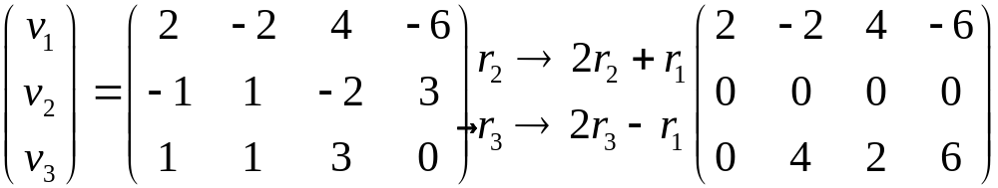
3.5. RowA, colA and nullA subspaces
Solution:
Set
colA = span{ }.
We have

Slide 89
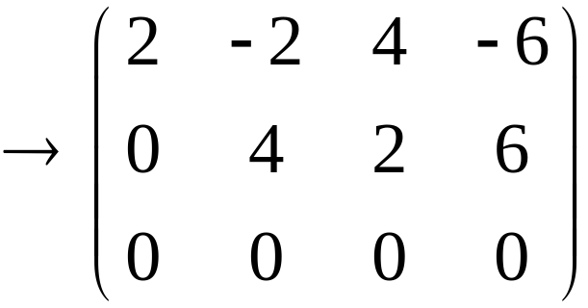
3.5. RowA, colA and nullA subspaces
Solution:
colA = span{ }=span{(2,-2,4,-6),(0,4,2,6)}
Because E = {(2,-2,4,-6),(0,4,2,6)} is linear independent.
So, E = {(2,-2,4,-6),(0,4,2,6)} is a basis of colA.
dim(colA)=2.

Slide 90
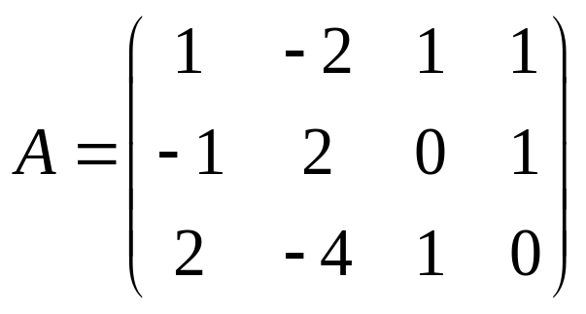
3.5. RowA, colA and nullA subspaces
Example 2:
Find bases of nullA

Slide 91
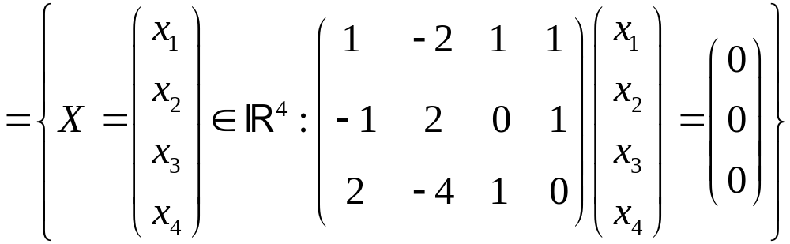
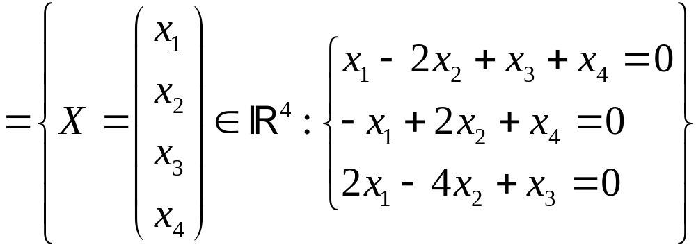
3.5. RowA, colA and nullA subspaces
Solution:
nullA = {X|AX = 0}

Slide 92
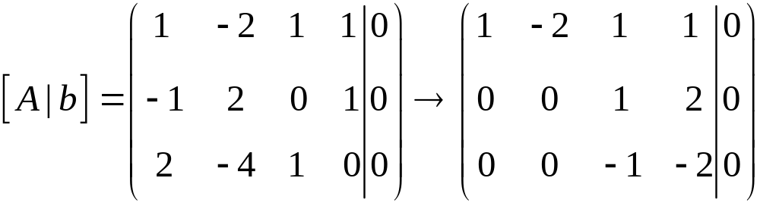
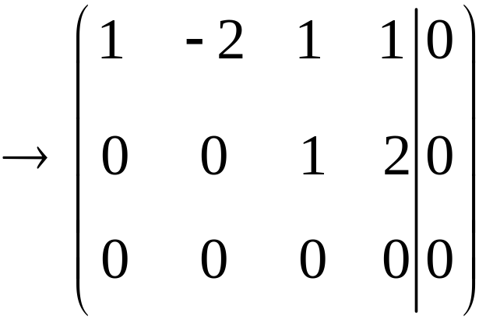
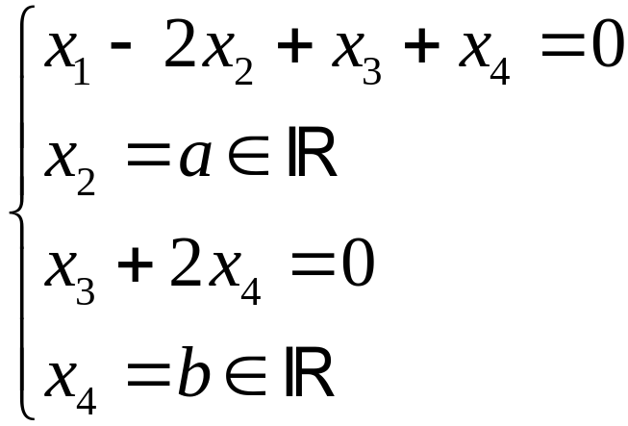
3.5. RowA, colA and nullA subspaces
Solution:
We have
. Hence,

Slide 93
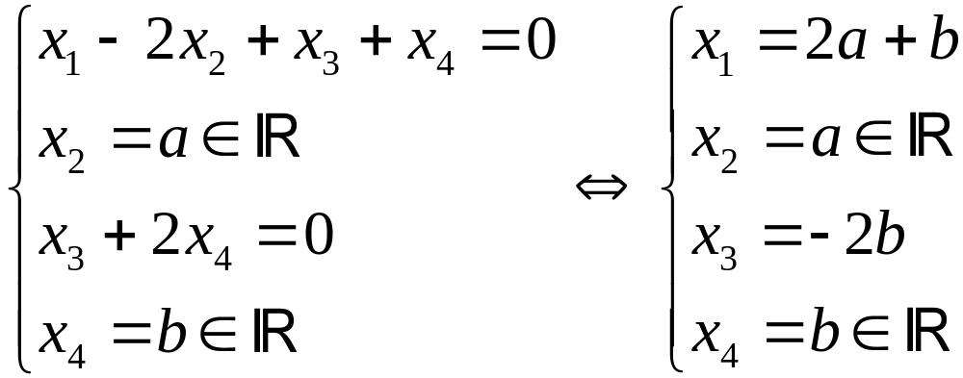

3.5. RowA, colA and nullA subspaces
Solution:
nullA = {X=(2a+b,a,-2b,b)|a,b }
=span{(2,1,0,0),(1,0,-2,1)}
Because E = {(2,1,0,0),(1,0,-2,1)} is linear independent. So, E = E = {(2,1,0,0),(1,0,-2,1)} is a basis of nullA,dim(nullA)=2.

Slide 94
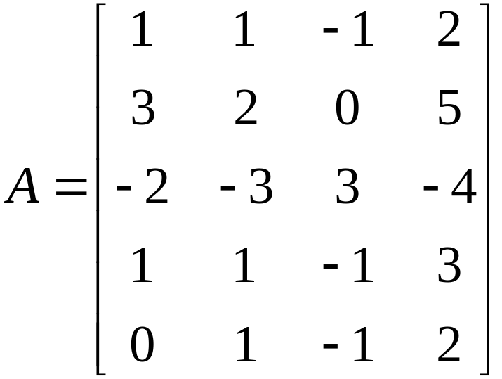
3.5. RowA, colA and nullA subspaces
Example 3:
Find bases for the row and column spaces of
and determine the rank of

Slide 95
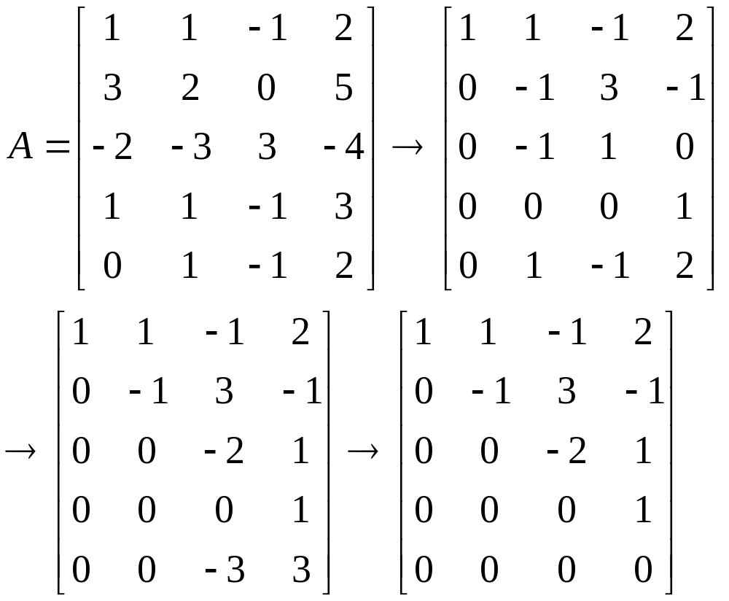
3.5. RowA, colA and nullA subspaces
Solution:
A basis of rowA is {r₁,r₂,r₃,r₄} and dim(rowA)=4
A basis of colA is {c₁,c₂,c₃,c₄} and dim(colA)=4

Slide 96
3.5. RowA, colA and nullA subspaces
Theorem
An nxn matrix A is invertible if and only if rankA=n
If an mxn matrix B has rank n then the n columns of B is linearly independent
If A is mxn matrix and m>n then the set of m rows of A is not independent

Slide 97
3.5. RowA, colA and nullA subspaces
Theorem
If an mxn matrix A has rank r then
The equation AX=0 has n-r basic solutions X₁,X₂,…,X_{n-r}
{X₁,X₂,…,X_{n-r}} is a basis of nullA
Dim nullA=n-r
imA = colA and
Dim imA=dim colA=rankA=r

Slide 98
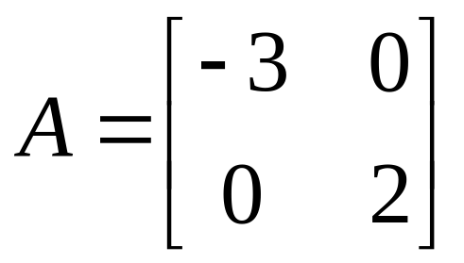
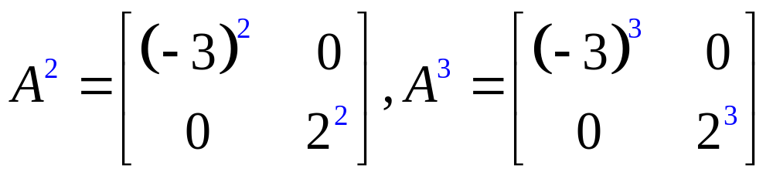
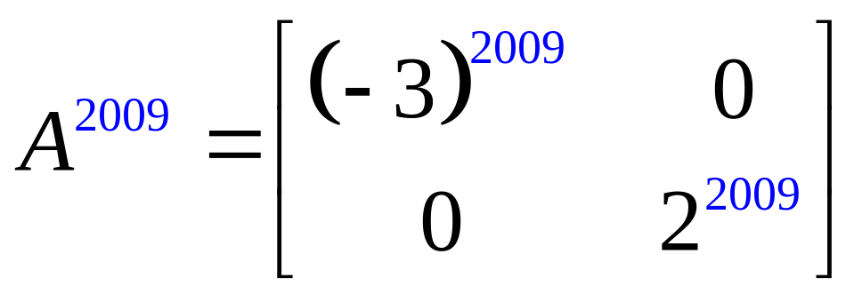
Example:
3.6. Diagonalization and Eigenvalues
Compute A²,A³, and A²⁰⁰⁹ if

Slide 99
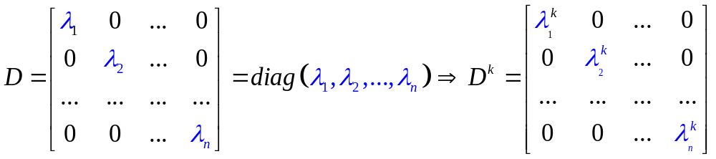
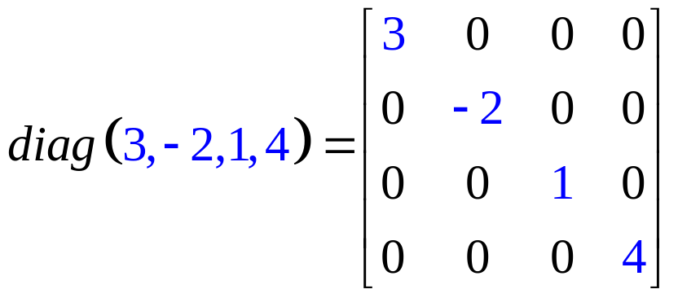
3.6. Diagonalization and Eigenvalues
Definition:
An nxn matrix is called diagonal matrix if all its entries off the main diagonal are zeros
Example:

Slide 100
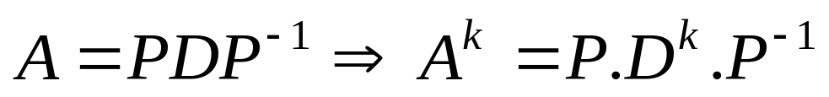

3.6. Diagonalization and Eigenvalues
Theorem:
If A is an nxn matrix, P is an invertible nxn matrix and D is a diagonal matrix then
Prove:

Slide 101




3.6. Diagonalization and Eigenvalues
Diagonalization
Diagonalizing a matrix A is to find an invertible matrix P such that
D = P⁻¹AP is a diagonal matrix P⁻¹AP=diag(₁, ₂,…, _{n})
Then, we have
Easy to compute A^{k}
Example:

Slide 102

3.6. Diagonalization and Eigenvalues
Example 1:
Find the eigenvalues ang eigenvectors and then
diagonalize the matrix

Slide 103

3.6. Diagonalization and Eigenvalues
Solution:
Đa thức đặc trưng (characteristic polynomial)
Các giá trị riêng (eigenvalues) của A

Slide 104


3.6. Diagonalization and Eigenvalues
Solution:
Nếu t≠0 thì X=(-4t,t) được gọi là véc tơ riêng (eigenvectors) ứng với giá trị riêng

Slide 105


3.6. Diagonalization and Eigenvalues
Solution:
Nếu t≠0 thì X=(t,t) được gọi là véc tơ riêng ứng với trị riêng

Slide 106

3.6. Diagonalization and Eigenvalues
Solution:
Nếu t≠0 thì X=(-4t,t) được gọi là véc tơ riêng (eigenvectors) ứng với giá trị riêng
Nếu t≠0 thì X=(t,t) được gọi là véc tơ riêng ứng với
Relationship between eigenvalues and eigenvectors
: eigenvalue (a number)
X: -eigenvector (remember: vector X≠0)
(I-A)X=0  AX=X

Slide 107

3.6. Diagonalization and Eigenvalues
Example 2:
Find the eigenvalues ang eigenvectors and then diagonalize
the matrix

Slide 108



3.6. Diagonalization and Eigenvalues
Example 2: Find the eigenvalues ang eigenvectors and then diagonalize
the matrix
Solution:
The characteristic polynomial of A is

Slide 109
3.6. Diagonalization and Eigenvalues
When is A diagonalizable ?
Theorem
A is diagonalizable iff every eigenvalue  of multiplicity m yields exactly m basic eigenvectors, that is, if the general solution of the system (I-A)X=0 has exactly m parameters.

Slide 110




3.6. Diagonalization and Eigenvalues
Example 1:

Slide 111

3.6. Diagonalization and Eigenvalues
Example 2:

Slide 112



3.6. Diagonalization and Eigenvalues
Solution:

Slide 113

3.6. Diagonalization and Eigenvalues
Example 3:
Determine whether is diagonalizable.

Slide 114






3.6. Diagonalization and Eigenvalues
Exercise 1: In each case find the characteristic polynomial, eigenvalues, eigenvectors, and (if possible) an invertible matrix such that is diagonal.
a/ b/
c/ d/

Slide 115

3.6. Diagonalization and Eigenvalues
Solution:
Step 1:

Slide 116

3.6. Diagonalization and Eigenvalues
Solution:
Step 2:

Slide 117

3.6. Diagonalization and Eigenvalues
Solution:
Step 3:

Slide 118

3.6. Diagonalization and Eigenvalues
Solution:
Step 4:

Slide 119




3.6. Diagonalization and Eigenvalues
Exercise 2: In each case find the characteristic polynomial, eigenvalues, eigenvectors, and (if possible) an invertible matrix such that is diagonal.
a/ b/
c/ d/

Slide 120

3.6. Diagonalization and Eigenvalues
An Application to Linear Recurrences
Linear recurrence: x_{k+2}=ax_{k}+bx_{k+1}
How to find a formula of x_{k}?
For example, find x_{k} if x₀=1, x₁=1,and x_{k+2} = 10x_{k} - 3x_{k+1}

Slide 121







3.6. Diagonalization and Eigenvalues
Example:
Slove the following linear recurrences
, where and
a/ b/
c/ d/

Slide 122
3.6. Diagonalization and Eigenvalues
Question 1:
Let A be an 3x3 matrix has three eigenvalues 1, -2, 3. Find its determinant.
A. not enough data to find.
B. 2
C. -6
D. 0

Slide 123







3.6. Diagonalization and Eigenvalues
Question 2:
Consider the matrix . Choose the correct
statements:
a/ is an eigenvector of b/ is an eigenvector of
c/ is an eigenvector of d/ is an eigenvector of

Slide 124

3.6. Diagonalization and Eigenvalues
Question 3:
Find the eigenvalues of
a/ 1,2,3 b/ -1,0,1 c/ 2,3
d/ 1,3 e/ -1,0 f/ 1,2

Slide 125






3.6. Diagonalization and Eigenvalues
Question 4:
If is an eigenvalue of , then (select the correct answers)
a/ b/
c/ is invertible d/ is not invertible.
e/
Notes:
Ans: b,d

Slide 126



3.6. Diagonalization and Eigenvalues
Question 5:
If all the eigenvalues of are nonzero, then (select the correct answers)
a/ b/
c/ is invertible d/ is not invertible.
e/
Notes:
Ans: c,e

Slide 127





3.6. Diagonalization and Eigenvalues
Question 6:
If a , invertible matrix has eigenvalues 2 and 5, answer the following True or False:
a/ is invertible b/ is diagonalizable.
c/ is symmetric d/
e/
f/ for some invertible

